Slide 1

OOP (IT-2005)
KALINGA INSTITUTE OF INDUSTRIAL TECHNOLOGY
School of Computer Engineering
Strictly for internal circulation (within KIIT) and reference only. Not for outside circulation without permission
3 Credit
Lecture Note

Slide 2

Why study OOP?
Object-Oriented Programming or OOP refers to the language that uses objects in programming.
OOP is used to solve real-world problems.
Client-Server Systems
Object-Oriented Databases
Office Automation Systems
Parallel Programming
Expert systems
It uses the DRY “Don’t Repeat Yourself” principle which makes code easy to maintain modify and debug.
P
HS
E
SA
P: Placement
HS: Higher study
E: Entrepreneurship
SA: Social activity
4 pillars

Slide 3
Course Outcome
CO1: understand the difference between structure-oriented programming and object-oriented programming.
CO2: use object-oriented programming language like C++ and associated libraries to develop object oriented programs.
CO3: apply various object-oriented features like class, object, inheritance, data abstraction, encapsulation, polymorphism to solve various computing problems using C++ language.
CO4: understand and apply concepts of operator-overloading, constructor and destructor
CO5: understand the and apply exception handling and use built-in classes from STL
CO6: implement, test and debug solutions in C++.

Slide 4
Course Contents
Sr # | Major and Detailed Coverage Area | Hrs
1 | Object Oriented Paradigm | 2
 | Evolution of programming paradigm: Procedure oriented programming Vs. Object-oriented programming (OOP) Object oriented programming concepts: Classes, objects, encapsulation and abstraction, inheritance, polymorphism, dynamic binding, message passing
2 | C++ Programming basics | 6
 | Review of fundamental constructs of C used in C++ : Character set, Keyword, Constant, Variable, Data types, operator & expression, control structure (branching & looping), typecasting, array & strings C++ Programming basics: Streams based I/O (Input with cin, Output using cout), Type bool, The setw manipulator, Type conversions, strict type checking, name space, scope resolution operator (::) Variables: Scope & lifetime of variables, variable declaration at the point of use, Ordinary Variable Vs. Pointer Variable Vs. Reference Variable (variable aliases) Function: Parameter passing by value Vs. by address Vs. by reference, inline function, function overloading, default arguments.

Slide 5
Course Contents cont…
Sr # | Major and Detailed Coverage Area | Hrs
3 | Object and Classes | 4
 | Defining class with functions and data members Access specifier: private Vs. public Creating & deleting objects by using new and delete operators respectively, Array of objects, Objects as function argument Static Data members and member functions Friend function, friend class Function with default arguments, function overloading
4 | Constructors and Destructors | 3
 | Definition of constructors & its uses Types of constructors: default constructor, parameterized constructor, copy constructor, constructor with dynamic allocation, Dynamic Constructors Constructor Overloading Destructors

Slide 6
Course Contents cont…
Sr # | Major and Detailed Coverage Area | Hrs
5 | Inheritance | 6
 | Concept of inheritance: defining derived and base classes, Class hierarchies, public, private, and protected derivations Types of Inheritance: Single Inheritance, Multilevel Inheritance, Multiple Inheritance, Hierarchical Inheritance, Hybrid Inheritance Virtual base class: Function overriding Constructors/Destructors in derived classes: Constructors invocation and data members initialization in derived classes Member classes: classes within classes
Mid Semester
6 | Operator Overloading | 3
 | Introduction to operator overloading Overloading unary operators, binary operators Overloading binary operators using friend function Rules for overloading operators

Slide 7
Course Contents cont…
Sr # | Major and Detailed Coverage Area | Hrs
7 | Polymorphism | 3
 | Introduction to pointers: Pointers to objects, pointer to derived class object, this pointer Compile time polymorphism : Function Overloading & Operator overloading Run time polymorphism : virtual functions, pure virtual functions, abstract class, virtual constructors & destructors
8 | Files and Streams | 4
 | Introduction to file handling: text file Vs. binary file Hierarchy of file stream classes: Functions of File Stream classes File modes Sequential access: The get(), getline() and put() functions The read() and write() functions Reading and writing class objects File pointers & their Manipulations: two file pointers (get pointer, put_pointer), Functions for manipulation of file pointers (seekg(), seekp(), tellg(), tellp()) Updating a File: Random Access Error handling during file operation: Error handling functions (eof(), fail(), bad(), good())

Slide 8
Course Contents cont…
Sr # | Major and Detailed Coverage Area | Hrs
9 | Exception Handling | 2
 | Basics Of Exception Handling Exception Handling Mechanism: The keyword try, throw and catch
10 | Templates | 2
 | Need of template Class Templates: Definition, Class Template with multiple parameters Function Templates: Definition, Function Template with multiple parameters
End Semester

Slide 9
Recommended Books
Textbook
Object Oriented Programming with C++ by Reema Thareja, 2nd Edition
Object Oriented Programming with C++, E. Balaguruswamy, 7th Edition, 2013 TMG Hill
Reference Books
C++ completes reference, Herbert Schildt, TMG Hill, 4th Edition, 2002.
C++ How to Program, Deitel and Deitel, Pearson Education Asia, 8th Edition, 2011.
Object Oriented Programming with Ansi and Turbo C++, Ashok N Kamthane, Pearson Education, 1st Edition, 2003.

Slide 10



Evaluation and Prerequisites
Grades will be based on
Prerequisites
PC (CS-1001)
Internal sending - 30 marks
Midterm exam - 20 marks
End term exam - 50 marks
Internal sending
2 assignments = 2 X 2.5 = 5 marks
2 quizzes = 2 X 2.5 = 5 marks
Class participation = 10 marks
Mini project = 10 marks

Slide 11
Evolution of Programming Paradigm
Programming Paradigm
Paradigm means methodology.
A programming paradigm is a fundamental style of computer programming or the programming technique that defines how the structure and basic elements of a computer program is built.
While some programming languages strictly follow a single paradigm, others may draw concepts from more than one.
Types of Programming Paradigm
Monolithic Programming – emphasizes on finding a solution
Structured Programming – focus on modules
Procedure-oriented Programming – lays stress on algorithms
Object-oriented Programming – emphasizes on classes and objects

Slide 12
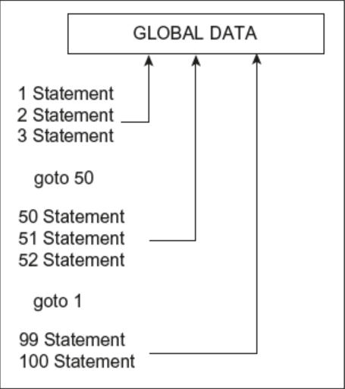
Monolithic Programming
It indicates the program which contain a single function for the large program.
A program is not divided into parts and hence is the name.
It is a single thread of execution. When the program size increases it leads inconvenience and difficult to maintain.
The program contains jump statements such as goto that transfers control to any statement as specified in it.
The global data can be accessed and modified from any part of the program and hence posing a serious threat to its veracity.
It is suitable for developing small and simple applications
Example: Basic

Slide 13
Evolution of Programming Paradigm cont…
Structured Programming
Programming tasks can be split into smaller sections known as functions or subroutines, which can be called whenever they are required.
It is often (but not always) associated with a “top down” approach to design.
It attempts to divide the problem into smaller blocks or procedures which interact with other.
The aim is to clearly define the structure of the program before writing program code.
Examples: Pascal, Ada, C
Procedure-oriented Programming
It basically consists of writing a list of instructions for the computer to follow and organizing these instructions into groups known as functions.
The primary focus is on functions.
Examples: COBOL, FORTRAN

Slide 14
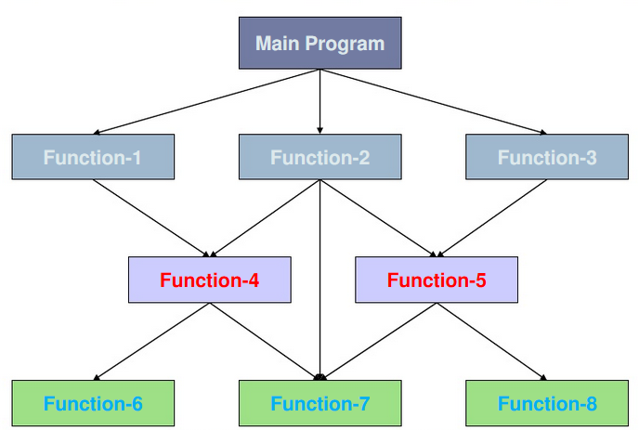
Procedure-oriented Programming cont…
Typical Program Structure of Procedure-oriented Programming

Slide 15
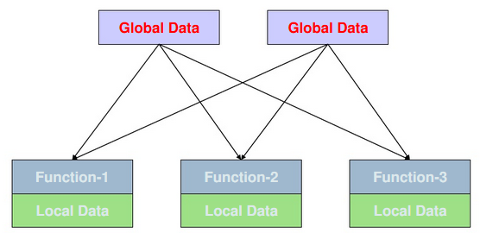
Procedure-oriented Programming cont…
Characteristics
Emphasis is on doing things (algorithms)
Larger programs are divided into smaller programs known as functions
Most of the functions share global data
Data move openly around the system from function to function
Functions transform data from one form to another
Employs top-down approach in program design
Relationship of data and functions

Slide 16
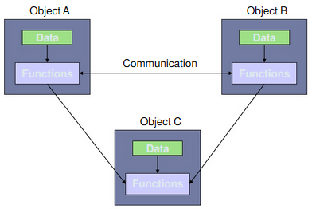
Object-oriented Programming
It treat data as a critical element in the program development and does not allow it to flow freely around the system.
It ties data more closely to the functions that operate on it, and protects it from accidental modification from outside functions.
OOP allows decomposition of a problem into a number of entities called objects and then build data functions around these objects.
The data of an object can be accessed only by the functions associated with that object. Functions of one object can access the functions of another objects.
Organization of data and functions

Slide 17
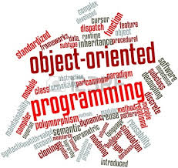
Object-oriented Programming cont…
Characteristics
Emphasis is on data rather than procedure.
Programs are divided into objects.
Data structures are designed such that they characterize the objects.
Functions that operate on the data of an object are tied together in the data structure.
Data is hidden and can not be accessed by external functions.
Objects may communicate with each other through functions.
New data and functions can be added easily whenever necessary.
Follows bottom-up approach in program design.

Slide 18

Basic Concepts
The object oriented language supports mechanism to define, create, store and manipulate objects and allow communication between objects. Some of the concepts are as follows -
Classes
Objects
Data abstraction
Encapsulation
Inheritance
Polymorphism
Dynamic Binding
Message Passing
Overloading

Slide 19
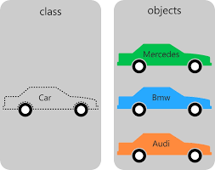
Classes
Classes are user-defined data types.
A class is a collection of data member and member functions.
Variable declared in class are called data member and functions declared in class are known as member functions.
Objects are variables of the type class. Once a class has been defined, we can create any number of objects belonging to that class.
Each object is associated with the data of type class with which they are created.
If car has been defined as a class, then the statement car Mercedes, car Bmw and car Audi is an object belonging to the class car.
It is a logical structure

Slide 20
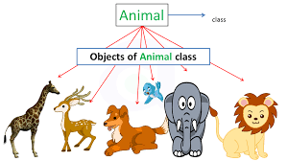

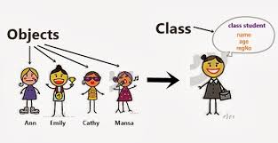
Classes Example
Class?
Objects?

Slide 21
Objects
Objects are the basic run-time entities in an object-oriented system.
They may represent a person, a place, a bank account, etc.
Objects take up space in the memory and have an associated address like a structure in C.
When a program is executed, the objects interact by sending messages to one another.
Every object have data structures called attributes and behavior called operations
Example : account
attributes: Account Number, Account Type, Name, Balance
behavior: Deposit, Withdraw, Enquire
Note
Class is a logical structure
Object is a physical actuality

Slide 22

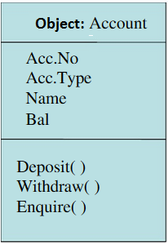
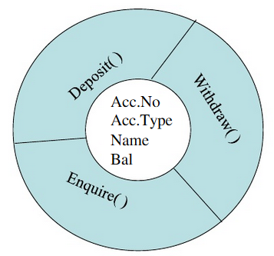
Object Representation Style

Slide 23
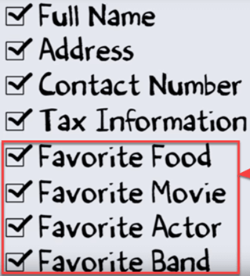
Data Abstraction
Data abstraction refers to providing only essential information to the outside world and hiding their background details, i.e., to represent the needed information in program without presenting the details.
Example - TV, which you can turn on and off, change the channel, adjust the volume, and add external components such as speakers, VCRs, and DVD players, BUT you do not know its internal details, that is, you do not know how it receives signals over the air or through a cable, how it translates them, and finally displays them on the screen. Thus, we can say a television clearly separates its internal implementation from its external interface and you can play with its interfaces like the power button, channel changer, and volume control without having zero knowledge of its internals.
Another Example -
Okay. Bank does not need all these customer information for the business.

Slide 24
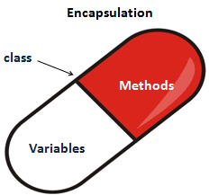
Data Encapsulation
The wrapping of data and functions into a single unit is known as encapsulation.
The data is not accessible to the outside world, and only those functions which are wrapped in the class can access it.
These functions provide the interface between the object’s data and the program. This insulation of the data from direct access by the program is called data hiding or information hiding.
The attributes wrapped in the classes are called data members and the functions that operate on these data are called methods or member functions.

Slide 25
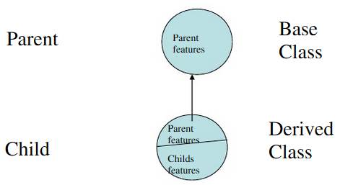
Inheritance
Inheritance is the process by which objects of one class acquire the properties of objects of another class.
It supports the concept of hierarchical classification.
Each derived class shares common characteristics with the class from which it is derived.
The main benefits of the Inheritance is code reusability i.e. add additional features to an existing class without modifying it.

Slide 26
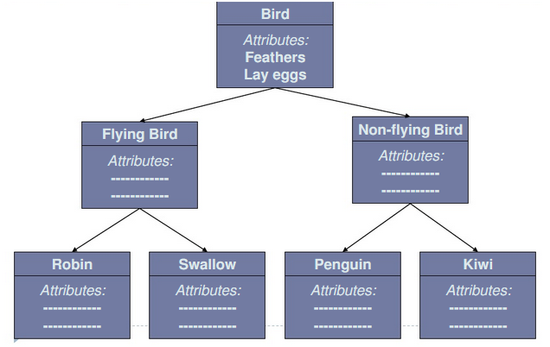
Inheritance Example

Slide 27
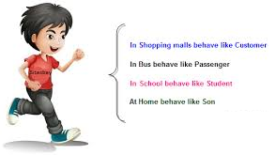
Polymorphism
Polymorphism is a Greek term and it means the ability to take more than one form.
An operation may exhibit different behaviors in different instances and the behavior depends upon the type of data used in the operation.
Example –
For adding two number operation will generate sum of two number.
For adding two string operation will concanete two string.
Add(3, 5) gives 8 and Add(“hello”, “world”) gives “hello world”

Slide 28
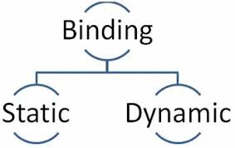
Binding
Binding refers to the linking of a procedure call to the code to be executed in response to the call.
Dynamic binding ( late binding ) means that the code associated with a given procedure call is not known until the time of the call at run-time.
It is associated with polymorphism and inheritance.
Happens at compile time
Happens at run time

Slide 29
Message Passing
It is a process of invoking an operation on an object.
Objects communicate with one another by sending and receiving information.
A message for an object is a request for execution of a function.
The receiving object will invoke a function and generates results.
Message passing involves specifying:
The name of the object
The name of the function
The information to be send
Example - student.setData(id, name);
Object
Message
Information

Slide 30
Overloading
Overloading is one type of Polymorphism.
It allows an object to have different meanings, depending on its context. When an existing operator or function begins to operate on new data type, or class, it is understood to be overloaded.
The process of making an operator to exhibit different behaviors in different instances is known as operator overloading. E.g. 3+5 equates to 8 and “Hello” + “ World” equates to “Hello World”
Using a single function name to perform different types of tasks is known as function overloading. E.g. sum(3, 5) equates to 8 and sum(3, 5, 7) equates to 15

Slide 31
Advantages of OOP
Through inheritance, redundant code is eliminated and extend the use of existing classes.
The principal of data hiding helps the programmer to build the secure program.
Message passing techniques for communication between objects makes the interface descriptions with external systems much simpler.
Multiple instances of an objects can co-exists with out any interference and can be easily managed.
Easily upgradable from small system to large system.

Slide 32


Slide 33

Home Work (HW)
How are data and functions organized in an object oriented system?
What do you mean by dynamic binding? How it is useful in OOP?
Describe how data are shared by functions in a procedure-oriented program.
What is object-oriented programming? How it is different from the procedure-oriented programming?
What are the merits and demerits of OOP?
Explain the concept of OOP.
Differentiate between class and object.
Differentiate between syntax errors and logical errors.
What is procedure-oriented programming? What are its main characteristics?

